Slide 1
The Impact of Sports Analytics on Modern Basketball Strategies
Subhanjan Baral

Slide 2
Table of Contents
Thesis Statement and Reasoning
Figure 1: Total Wins during 2016 – 2022
Figure 2: Average NBA 3 points attempted from 2016 to 2022
Golden State Warriors’ Investment in Analytics
Comparison of elite 3 points shooters

Slide 3
The development and application of sports analytics have been pivotal in transforming basketball strategies, with teams that embrace analytics outperforming those that rely solely on traditional methods.
Reasoning: I believe this because teams like the Golden State Warriors, known for their analytics-driven strategies (e.g., prioritizing 3-point shooting and efficient shot selection), have achieved notable success compared to traditional-playstyle teams.

Slide 4
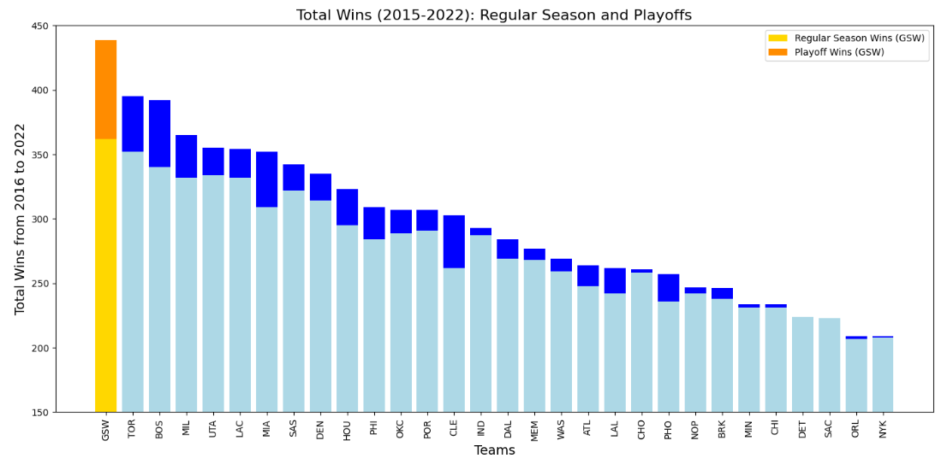
Despite losing key players in 2019/20 where they only won 15 games out of 75
Won 4 championships and went to 5 finals during this period.
Source: https://www.statmuse.com/nba/ask/warriors-record-over-last-10-seasons

Slide 5
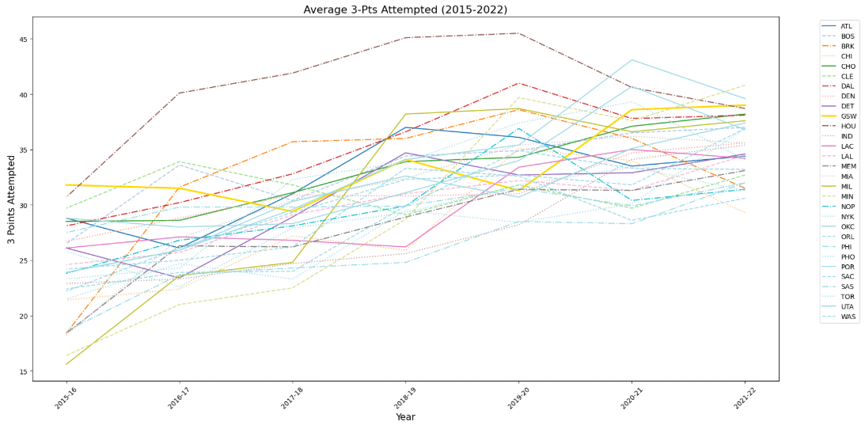
Revolutionized 3-pt Game
Source: https://www.basketball-reference.com/
https://www.statmuse.com/nba
https://www.teamrankings.com/nba/stat/three-pointers-attempted-per-game?date=2017-06-13

Slide 6
Investments in Analytics
Early Adoption: GSW was a pioneer in integrating analytics for game strategies, player performance, and health optimization, beginning as early as 2015.
Key Personnel: The hiring of Kirk Lacob in 2016 highlighted their focus on building an expert analytics team to inform decision-making and strategy (Bleacher Report, The Athletic).
Three-Point Revolution: GSW led the charge in optimizing three-point shooting with data-driven strategies, significantly outperforming other teams (ESPN, SB Nation).
Health & Recovery: Investments in wearables (e.g., WHOOP) helped monitor player fatigue and optimize recovery, crucial for sustained success (Forbes, The Athletic).
Player Development: GSW's analytics extended to scouting and player development, helping identify talent and improve player efficiency (The Ringer, Bleacher Report).
GSW's analytics-driven approach has set them apart, contributing to their dominance in the NBA during this period.

Slide 7
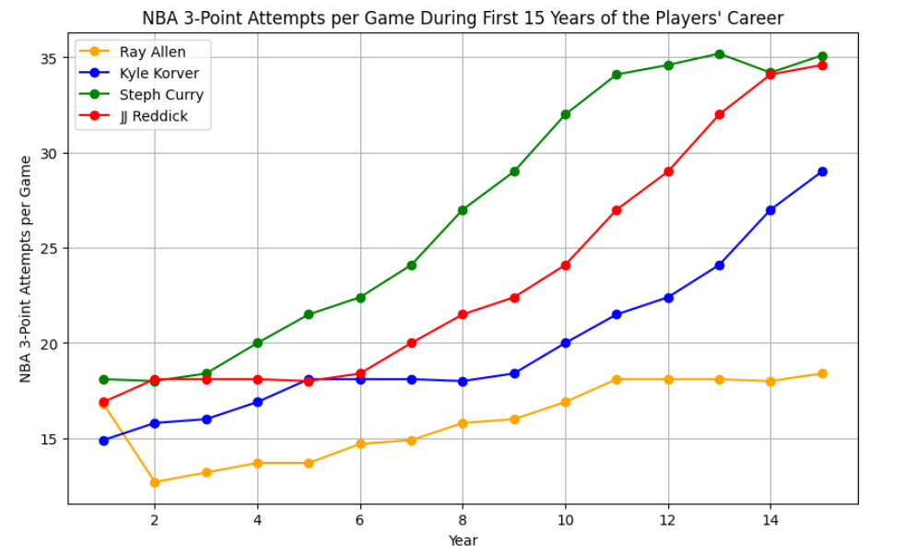
How Stephen Curry and GSW’s Strategies changed the game…

Slide 8
Thanks

